Slide 1



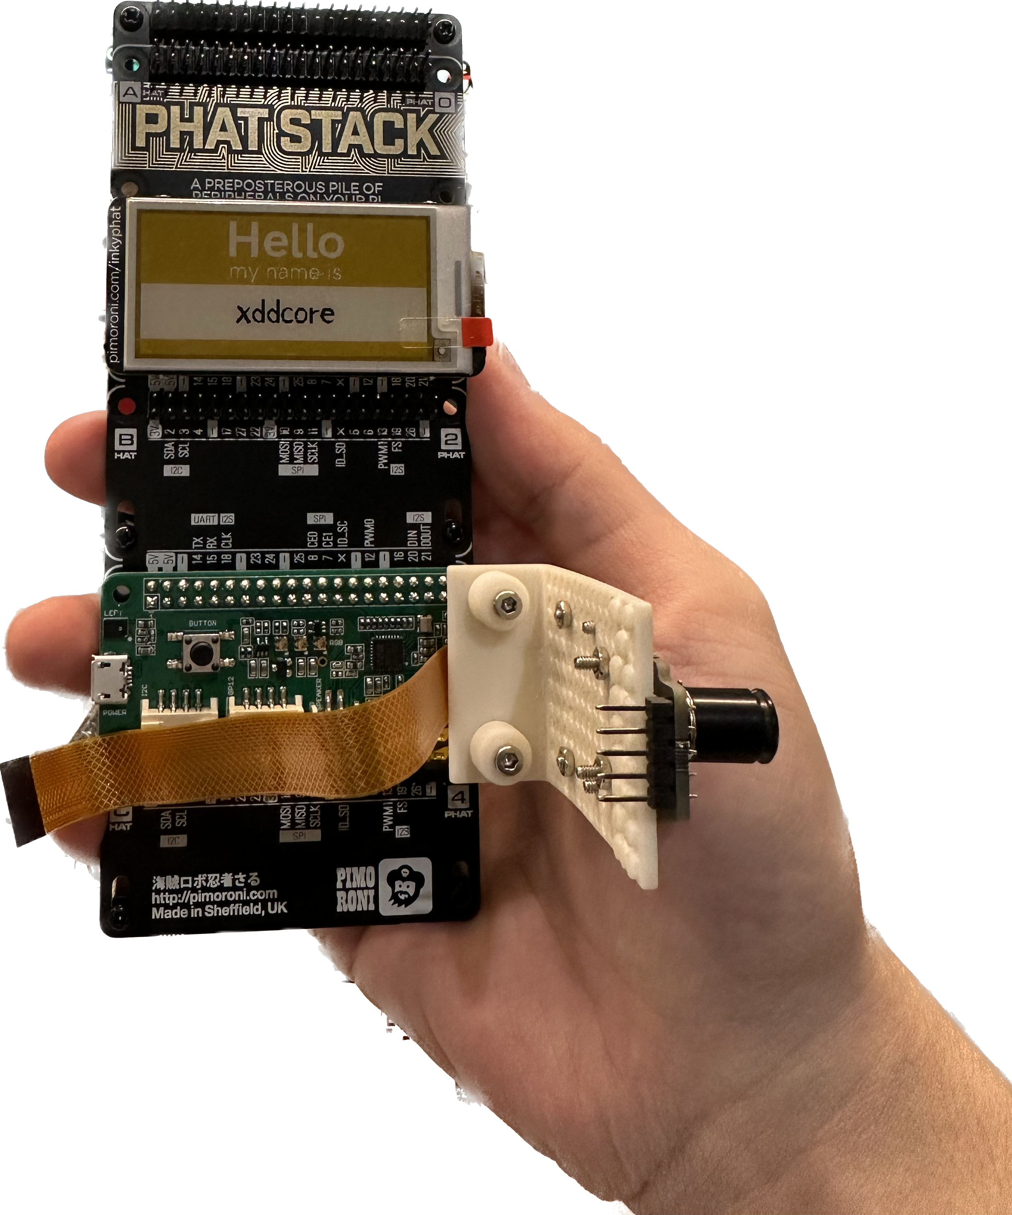

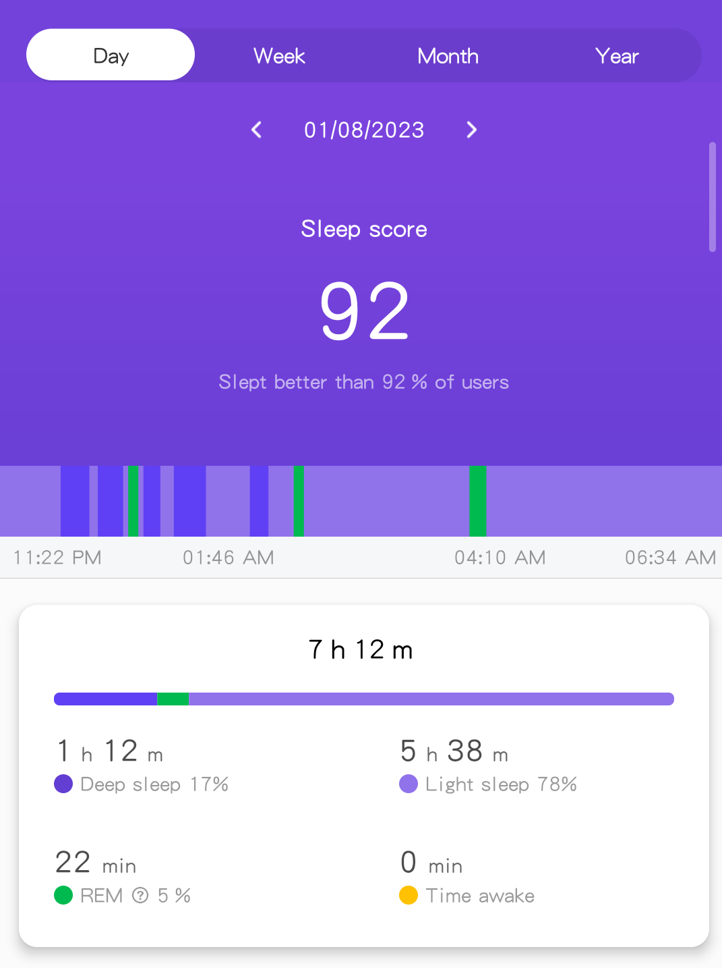









Sleep Panda: Your personal sleep manager
Step 1: Sleep Monitoring
Model Design Drawing
Example Sleeping Report
Raspberry Pi 4b
(bcm2711)
Step 2: Data Processing
Main Device Type
Sensor：
Sleeping position observation: 4K 30FPS
Heart rate & blood oxygen: MAX30101
Body temperature & gesture control: MLX90640
Speaker & Microphone: WM8960
Actuator：
Ink Screen: Virtual Zoo
Touchscreen: QT-based GUI
Buzzer: emergency abnormal alarm
Team 2: Sleep Panda
Rui Liu (2756138L)

